Slide 1
MODEL EXPERIMENTATION

Slide 2
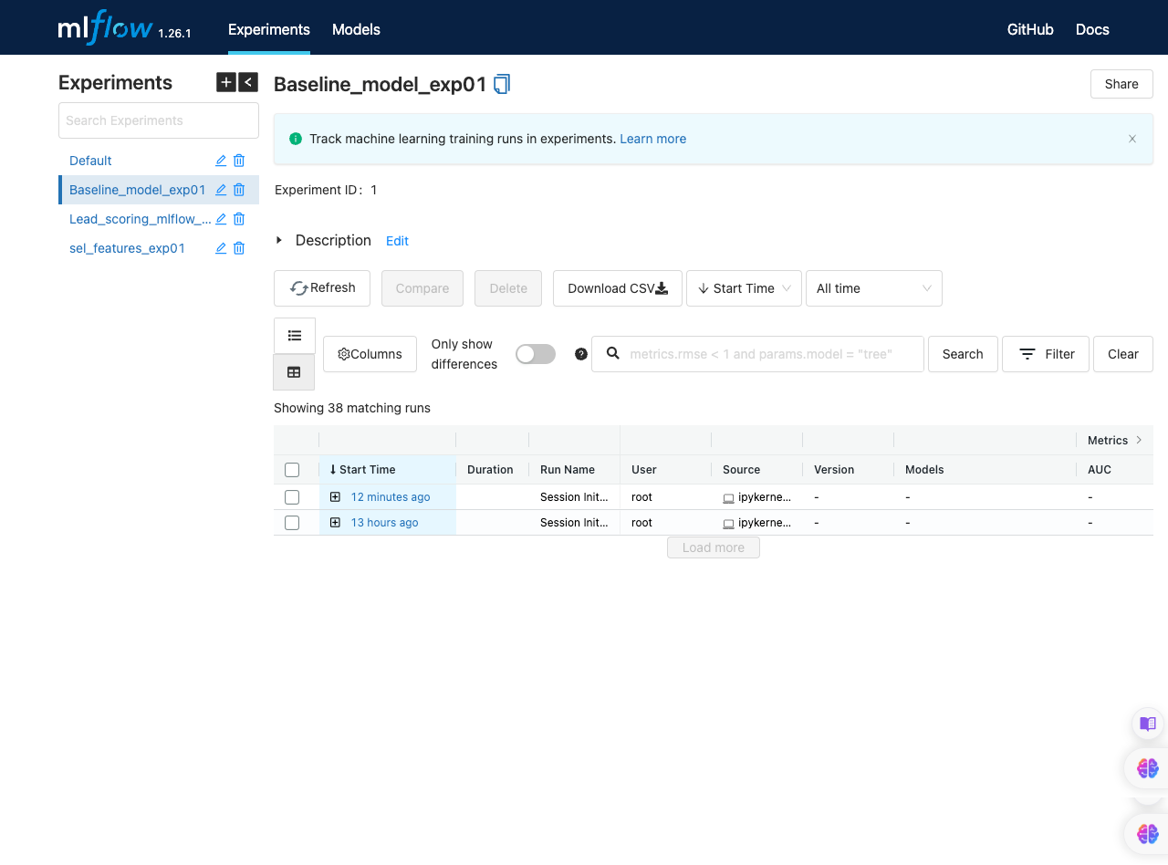
Screenshot of all Experiments

Slide 3
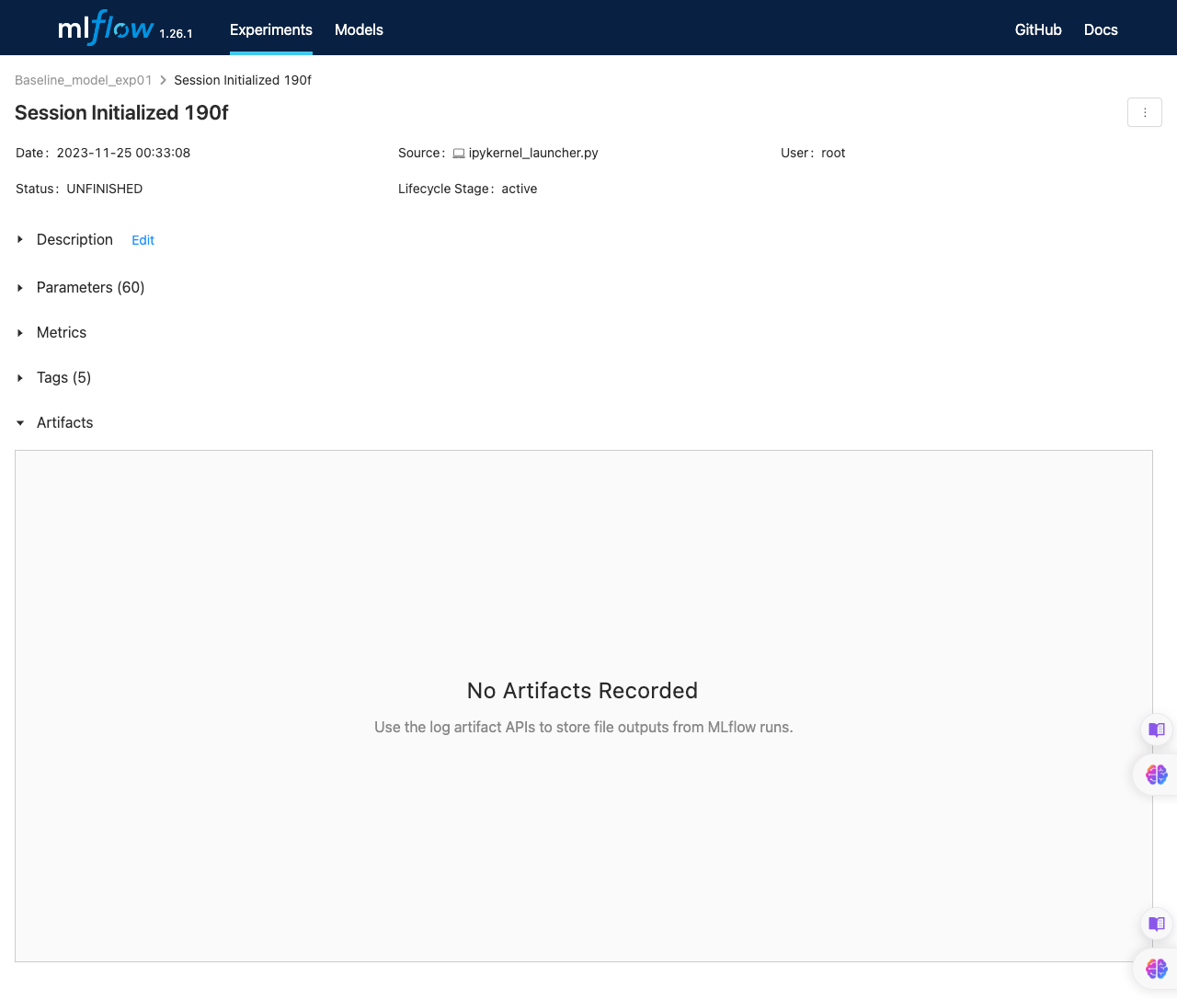
Screenshot of one experiments with all the artifacts visible
Even though the experiment ran from the training notebook, only the experiment is visible in mlflow but the metrics and models are not logged.
The pycaret documentation says logging of model artifacts is not supported by default for mlflow

Slide 4
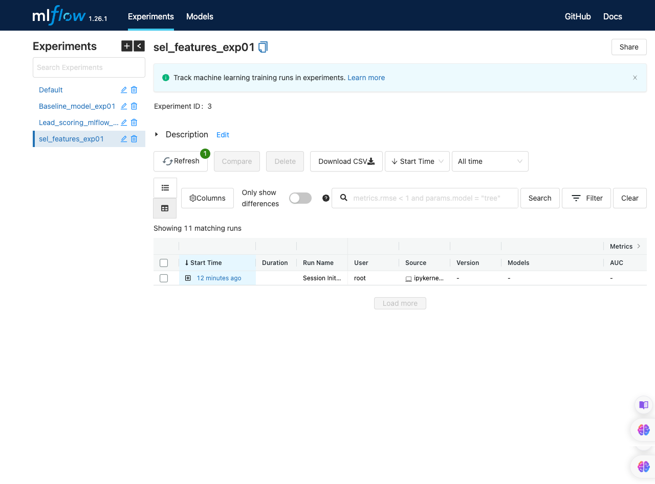
Screenshot of all the experiments (after dropping features)

Slide 5

Screenshot of one experiments with all the artifacts visible (after dropping features)
Even though the experiment ran from the training notebook, only the experiment is visible in mlflow but the metrics and models are not logged.
The pycaret documentation says logging of model artifacts is not supported by default for mlflow

Slide 6
TRAINING PIPELINE

Slide 7
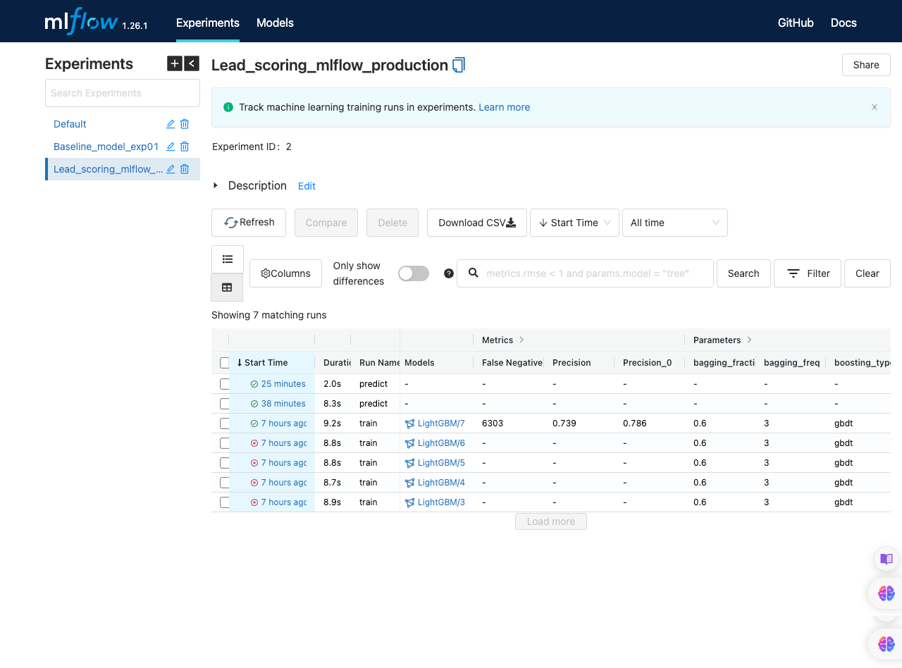
Screenshot of experiments with all the artifacts visible
Line #3 (LightGBM/7, with metrics info)

Slide 8
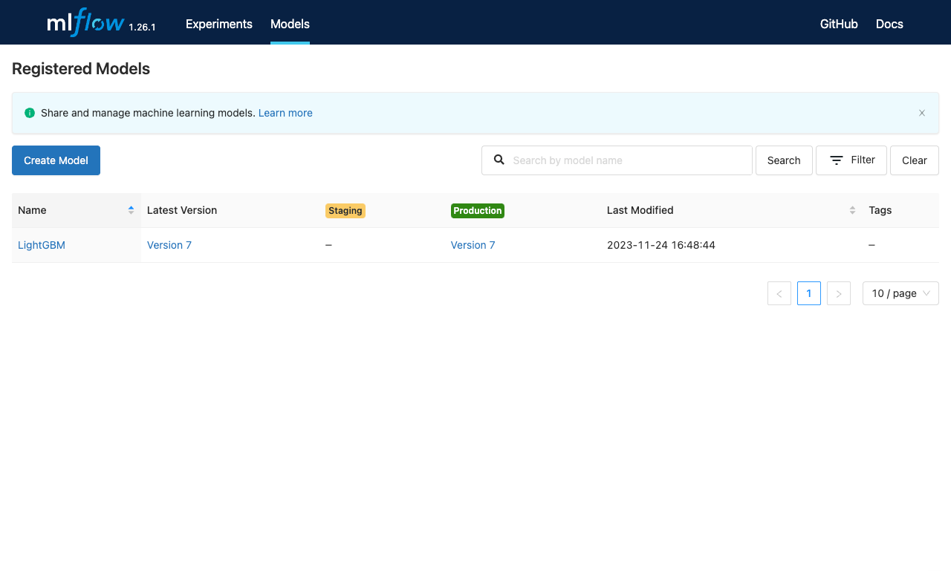
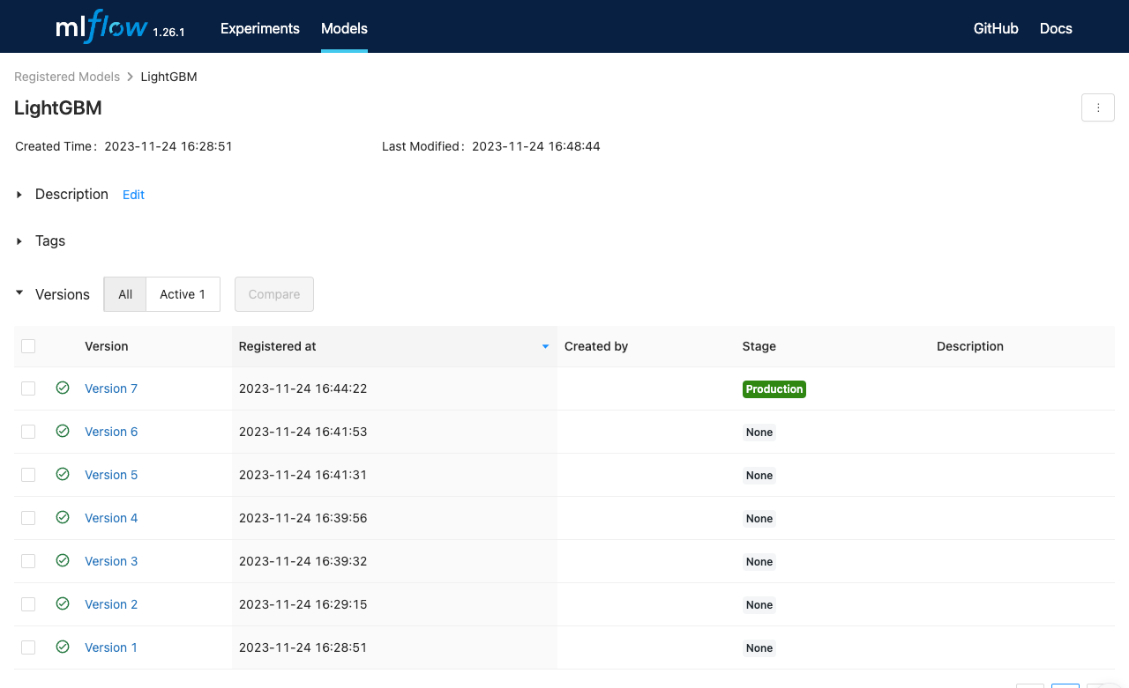
Screenshot of model registry with model name and stage as 'production'

Slide 9
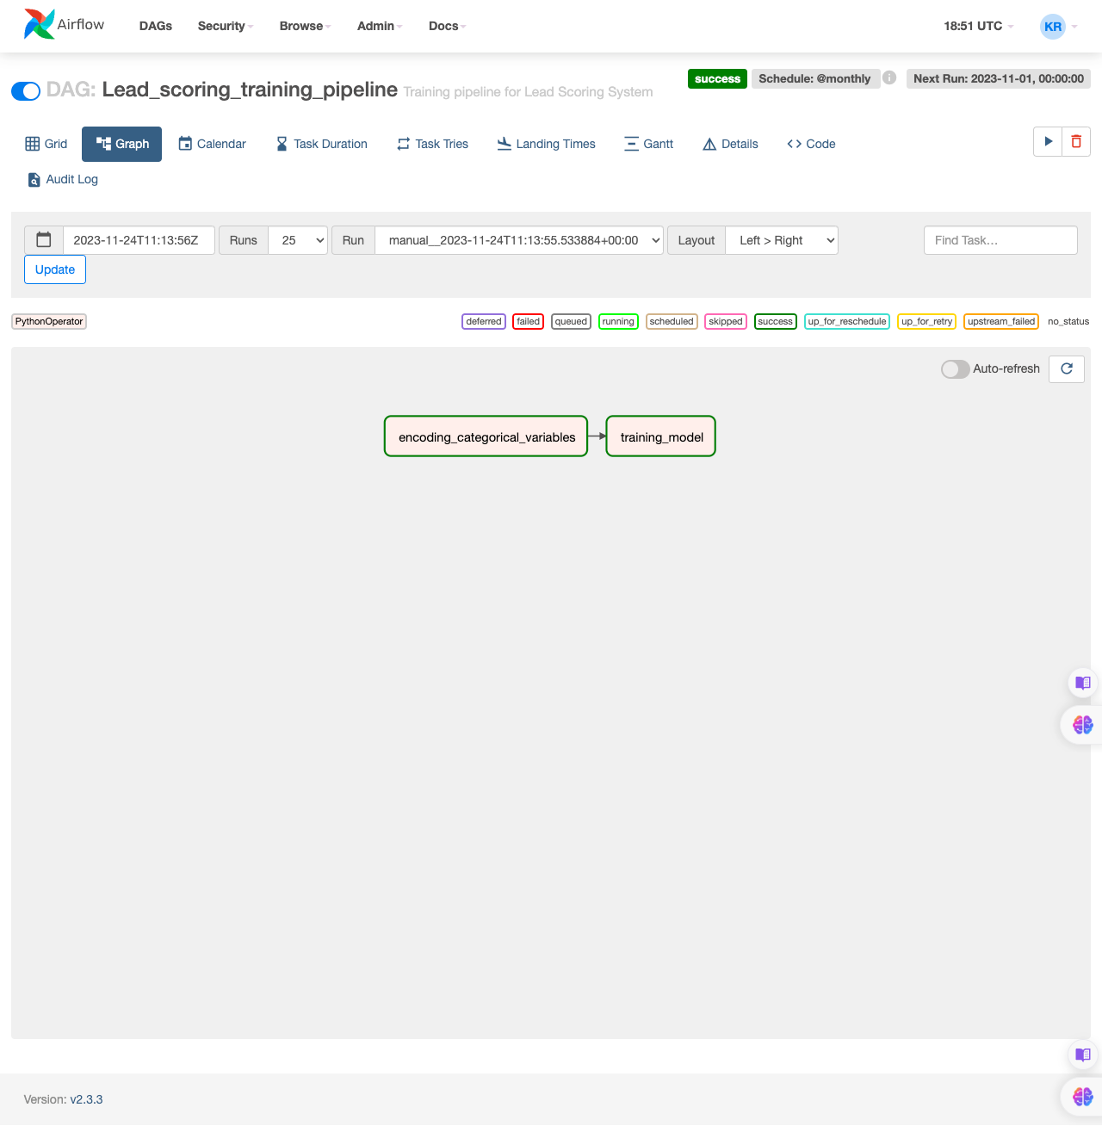
Screenshot of sucessful execution Airflow DAG in graph

Slide 10
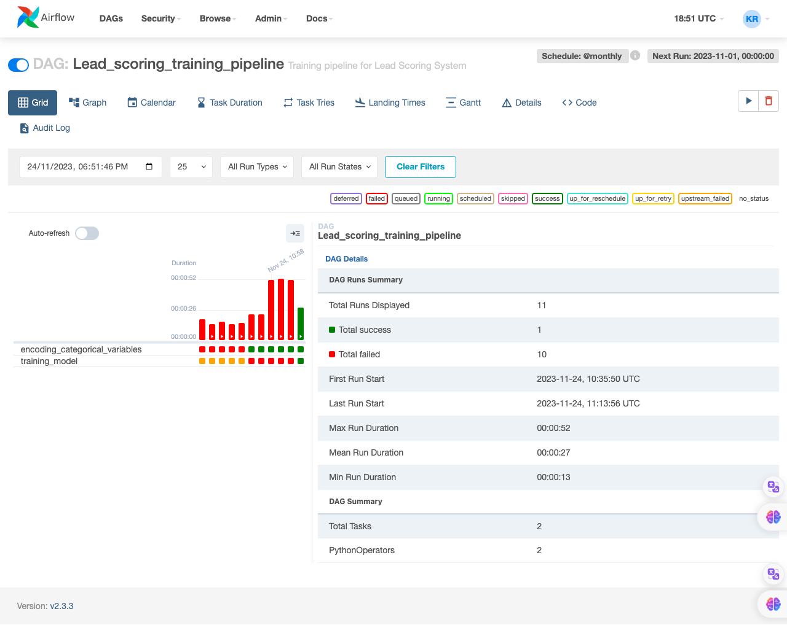
Screenshot of Airflow UI grid

Slide 11
INFERENCE PIPELINE

Slide 12
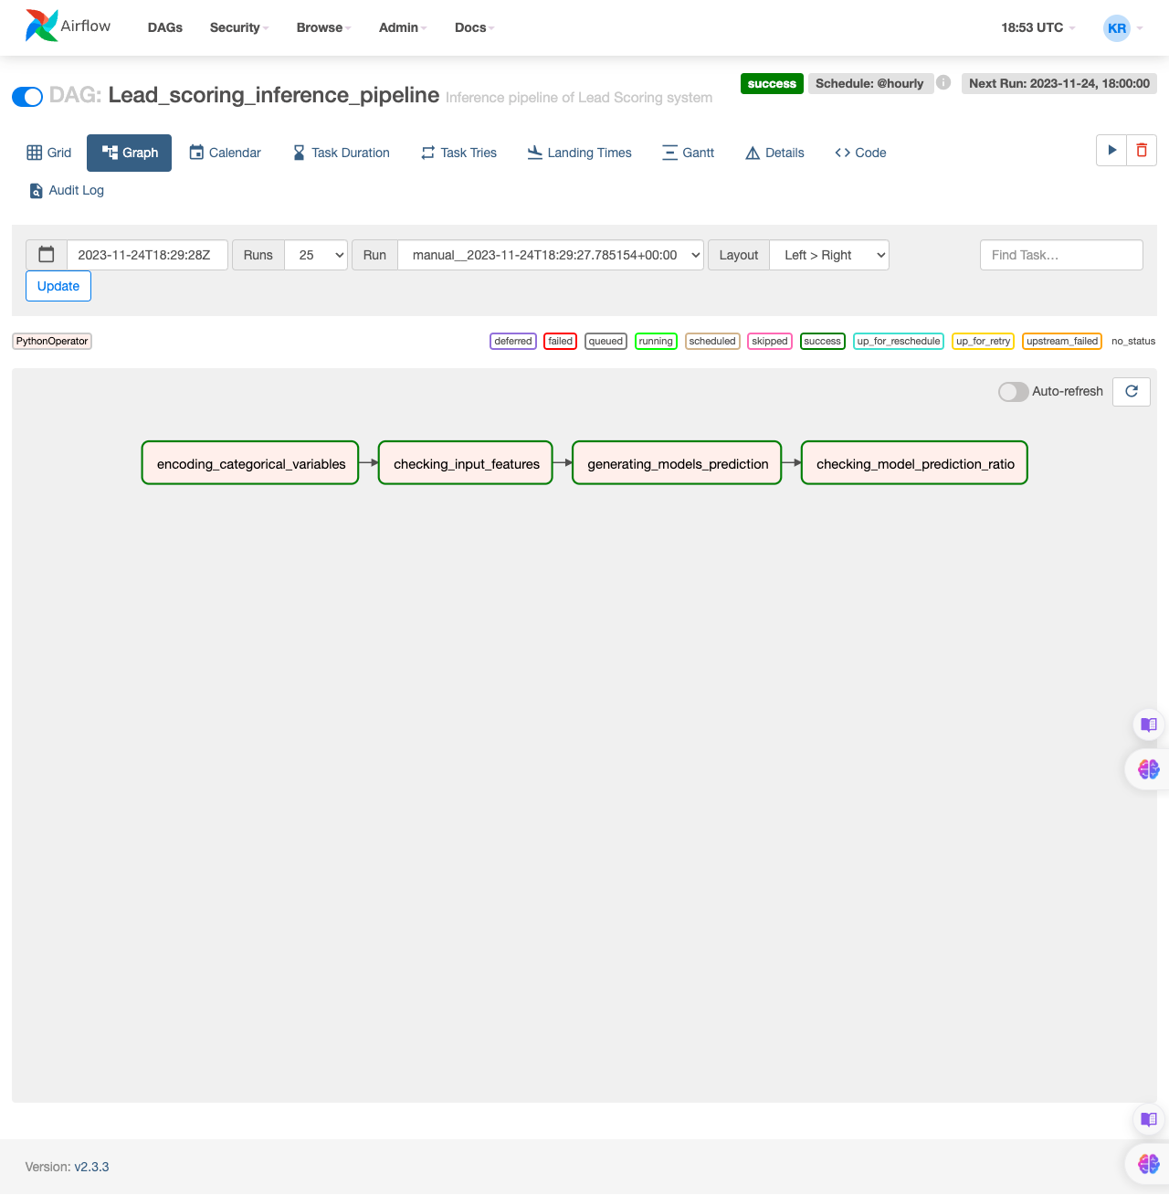
Screenshot of sucessful execution Airflow DAG in graph

Slide 13
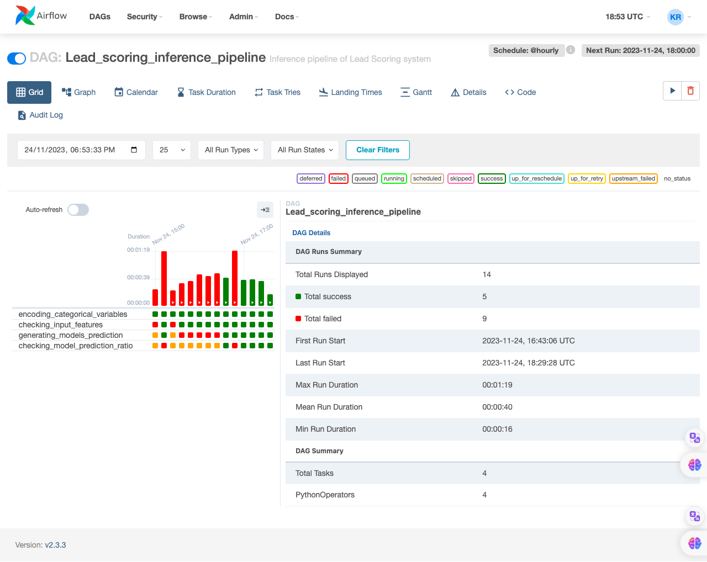
Screenshot of Airflow UI grid

